Slide 1


Compiler Construction
Lecture 02

Slide 2
Cross Compiler & T-Diagram

Slide 3
Objectives
You will learn about;
Unit 2.1 :
  Cross Compiler
Unit 2.2 :
  Bootstrapping
Unit 2.3 :
  T-Diagram

Slide 4
UNIT 2.1
Home
  Cross Compiler

Slide 5
Cross Compiler
A cross compiler is a compiler capable of creating executable code for a platform other than the one on which the compiler is running.
For example, a compiler that runs on a Windows 7 PC but generates code that runs on Android Smartphone is a cross compiler.
A cross compiler is necessary to compile code for multiple platforms from one development host. Direct compilation on the target platform might be infeasible, for example on a microcontroller of an embedded system, because those systems contain no operating system.

Slide 6
Cross Compiler
A host language is a language in which the compiler is written.
  T-diagram
Cross compilers are used very often in practice.
S
T
H

Slide 7
Cross Compiler
The fundamental use of a cross compiler is to separate the build environment from target environment. This is useful in several situations:
Embedded computers
Compiling on a server farm
Compiling for multiple machines (OS)
Bootstrapping

Slide 8
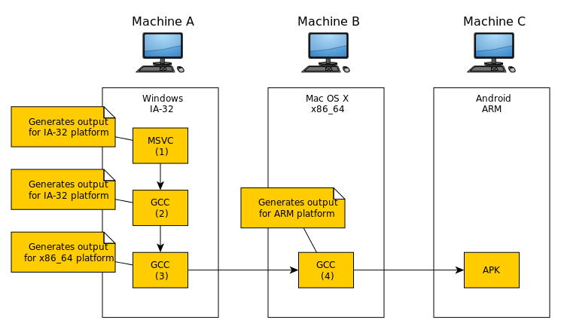
Canadian Cross
The Canadian Cross is a technique for building cross compilers for other machines.

Slide 9
UNIT 2.2
Home
  Bootstrapping

Slide 10
Bootstrapping
Bootstrapping is a technique that is widely used in compiler development. It has four main uses:
It enables new programming languages and compilers to be developed starting from existing ones.
2. It enables new features to be added to a programming language and its compiler.
3. It also allows new optimizations to be added to compilers.
4. It allows languages and compilers to be transferred between processors with different instruction sets

Slide 11
UNIT 2.3
Home
  T-Diagram

Slide 12
T-Diagram
Different diagrams for different kinds of programs
Visual explanation of interactions involving compilers and interpreters

Slide 13
Programs
Program P written in language L
Example: Sort program written in Java
P
sort
L
Java

Slide 14
Machines
Machine executing language M
Example: Sun workstation executing SPARC machine code
M
sparc

Slide 15
Executing Programs
Program implementation language must match machine
sort
sparc
sparc

Slide 16
Interpreters
Interpreter executing language L written in language M
Example: Lisp interpreter running on sparc
L
Lisp
L
Lisp
M
sparc
M
sparc

Slide 17
Interpreting Programs
Interpreter mediates between programming language and machine language
sort
Lisp
Lisp
Lisp
sparc
sparc
sparc

Slide 18
Virtual Machines
Interpreter creates a “virtual machine”
sort
sort
Lisp
Lisp
Lisp
Lisp
sparc
Lisp
sparc
sparc

Slide 19
Compilers
Compiler translating from source language S to target language T implemented in M
Example: C compiler for sparc platform
S
-->
T
C

sparc
M
sparc

Slide 20
Compiling Programs
Compiler inputs program in source language, outputs in target language
sort
sort
sort
C
C

sparc
sparc
sparc
sparc
sparc
sparc

Slide 21
Compiler Correctness
Compiled target program has the same meaning as the source program
sort
sort
C
==
sparc
C
sparc

Slide 22
Java Programming Environment
Javac: Java to Java byte code (JBC) compiler
Java: Java Virtual Machine byte code interpreter
P
P
P
Java
Java

JBC
JBC
JBC
M
JBC
JBC
M
“javac”
M
“java”
M
M

Slide 23
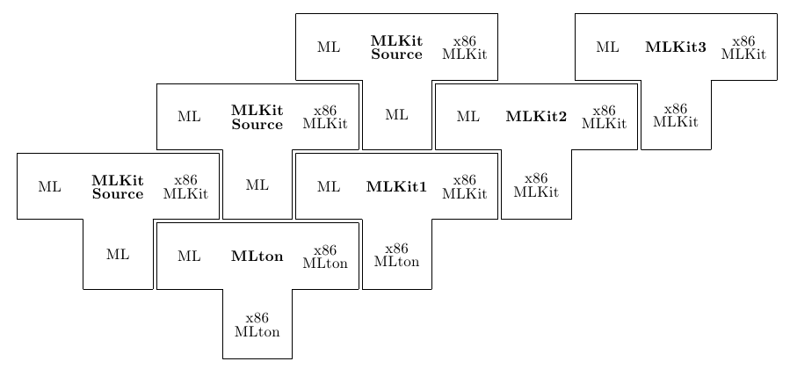
Exercises
Explain the terms:
Cross Compiler
Bootstrapping
Explain the working of given
Cross compiler

Slide 24
Thank you

Slide 25
Content Taken From
Web URL:
http://people.cs.bris.ac.uk/~dave/boot.pdf
http://www.cse.buffalo.edu/~drpierce/cse/443S2005/lectures/T-diagrams.ppt
https://en.wikipedia.org/wiki/Cross_compiler
https://en.wikipedia.org/wiki/Cross_compiler

